Slide 1


ST ANN’S SENIOR SECONDARY SCHOOL,
ROOKEE

Slide 2

ART INTEGRATED LEARNING PROJECT
COMPUTER SCIENCE
SESSION: 2021-22
SUBMITTED TO:
MRS. JASPREET OBHRAI MA’AM
SUBMITTED BY:
RIYA VERMA(19)
TANISHA PRAKASH(23)
CLASS- XII ‘B’

Slide 3

ACKNOWLEDGEMENT
In the accomplishment of this project successfully, many people have bestowed upon us their blessings and the heart pledged support. We would like to thank all those wonderful people and would like to express our gratitude to our CS teacher, Mrs. Jaspreet whose valuable guidance helped us through this project. We would also like to thank our parents and friends for their support.

Slide 4

CERTIFICATE
This is to certify that Riya Verma and Tanisha Prakash, students of class XII B have successfully completed the project assigned,
Under the guidance of Mrs. Jaspreet during year 2021-2022.
PRINCIPAL SIGNATURE:
SR. ALICE
TEACHER’S SIGNATURE
MRS. JASPREET

Slide 5

ABOUT THE PROJECT
This project is based upon the python programming done behind the making of a coffee shop website which deals with the selling of beverages and snacks by the means of e-commerce.
Café website brings a great choice and variety of beverages and snacks to enjoy.
WELCOME TO STEAMIN’ MUGS!💓

Slide 6

MAIN PROGRAM
FLOWCHART:
START
Input pass1
If ch==2
If pass1=“smugs”
else
if ch==1
F
F
Input ch
T
F
T
T
Print “wrong password”
If pass2=“rvtp”
F
Input pass2
IMPORT
CFUNC
T
FINISH
IMPORT RETAILER

Slide 7

ALGORITHM(customer):
START
MENU
COFFEE AND BEVERAGES
NON COFFEE DRINKS
PIZZA
SANDWICHES
SOUP
BURGER
CHINESE
PASTRIES
KARNATAKA SPECIAL MENU
(ANY OTHER KEY TO EXIT)
IF CHOICE IS 1:
AMERICANO
LATTE
CAPPUCHINO
FRAPPE
VANILLA COFFE
GREEN TEA
MILK TEA
BLACK TEA
mysql
ENTER QUANTITY
BILLING
PRINT BILL

Slide 8

IF CHOICE IS 2:
ITALIAN SODA
CREMOSA
HOT CHOCOLATE
HOT APPLE EXPLOSION
OREO SHAKE
FROZEN DRINKS
6.1 . SMOOTHIE
STRAWBERRY
BANANA
TROPICAL SUNSHINE
4-BERRY
LEMONANDE
MANGO TROPICS
PEACH -PEAR -APRICOT
PINEAPPLE PARADISE
6.2. MOCKTAIL
MANGO MULE
MAGIC APPLE
SHIRLEY GINGER
VIRGIN WATERMELON MARGARITA
BERRY BURLESQUE
LAVENDER LEMONADE
mysql
ENTER QUANTITY
BILLING
PRINT BILL

Slide 9
IF CHOICE IS 3:
MARGHERITA
FARM HOUSE
PEPPY PANEER
MEXICAN GREEN WAVE
CHEESE AND CORN
VEGGIE PARADISE
CHICKEN GOLDEN DELIGHT
IF CHOICE IS 4:
CHEESE GRILLED SANDWICH
MAYO SANDWICH
MAKHANI GRILLED SANDWICH
PANEER GRILLED SANDWICH
AALO TIKKI SANDWICH
IF CHOICE IS 5:
VEGETABLE SOUP
TOMATO SOUP
SWEET CORN SOUP
HOT AND SOUR SOUP
MUSHROOM SOUP
mysql
ENTER QUANTITY
BILLING
mysql
PRINT BILL
ENTER QUANTITY
BILLING
mysql
ENTER QUANTITY
BILLING

Slide 10
IF CHOICE IS 6:
VEG BURGER
CHEESE BURGER
TEXAS BURGER
IF CHOICE IS 7:
MOMOS
CHOWMEIN
RAMEN
GOLDEN FRIED BABY CORN
MANCHOW SOUP
IF CHOICE IS 8:
PINEAPPLE PASTRY
BLACKFOREST PASTRY
CHOCOLATE CHIP PASTRY
TRUFFLE PASTRY
RED VELVET PASTRY
IF CHOICE IS 9:
KARNATAKA SPECIAL MENU
mysql
ENTER QUANTITY
BILLING
mysql
ENTER QUANTITY
BILLING
PRINT
BILL
mysql
BILLING
ENTER QUANTITY
mysql
ENTER QUANTITY
BILLING
More than one selection available

Slide 11
ALGORITHM(employee):
START
RETAILER TASKS
Update item records
Delete item records
Insert item record
Display customer details
Send emails
Update employee records
Display graph
Exit
mysql
TABLE MENU UPDATED
Crecord.csv
PRINT CUSTOMER DETAILS
smtplib
EMAIL SENT TO : 1. CUSTOMER OR
2. EMPLOYEE
Erecord.csv
PRINT EMPLOYEE RECORDS
Matplotlib.byplot
GRAPH DISPLAYED

Slide 12

BIBLIOGRAPHY
www.zomato.com
www.ventureforth.com
www.bestslogans.com
www.townandcountrymag.com
https://www.freecodecamp.org

Slide 13
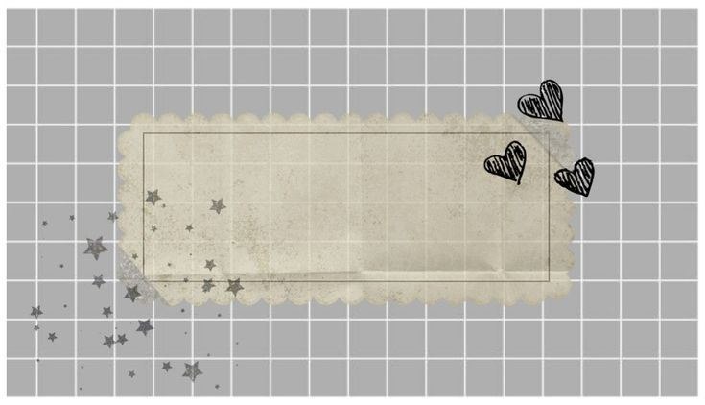
REMARK

Slide 14

MYSQL TABLES:

Slide 15
PYTHON CODE:

Slide 16
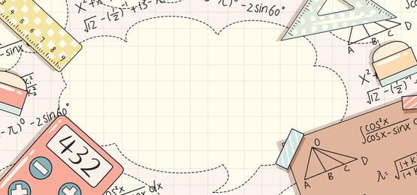
CUSTOMER END:

Slide 17
RETAILER END:

Slide 18
TEXT FILES:

Slide 19
CSV FILES:

